Slide 1

From despair to hope:
sentiment analysis of queer and trans API blogs
Binh Hoang

Slide 2


Introduction
Crowdsourced ideas from editors and contributors.
Interested in exploring:
Engagement
Sentiment

Slide 3

Data
34
+
=
376 blogs
342

Slide 4
Methodology
Data
Storage
Analysis
Viz
BeautifulSoup
Google Analytics
MongoDB
NLTK
Spacy
Vader
Scikit-learn
Seaborn
Plotly

Slide 5
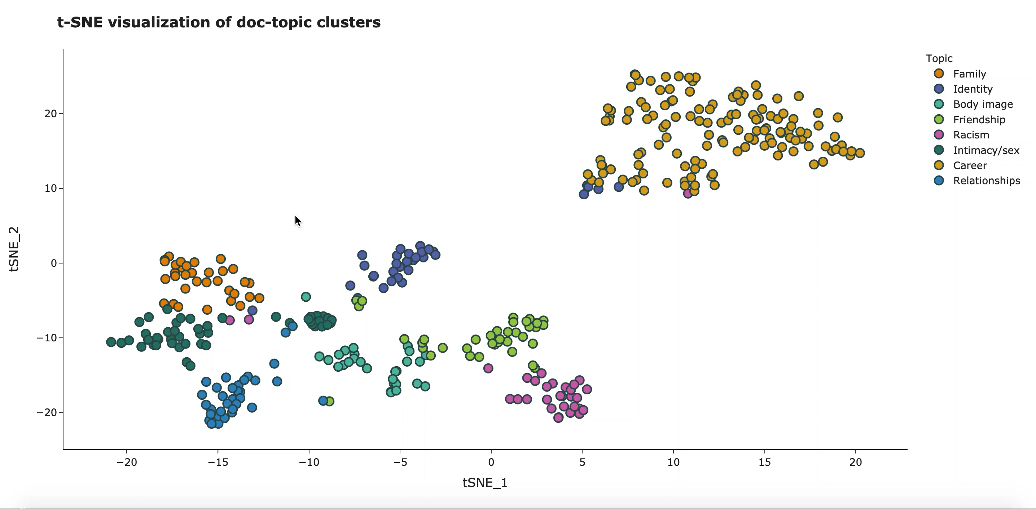

Slide 6
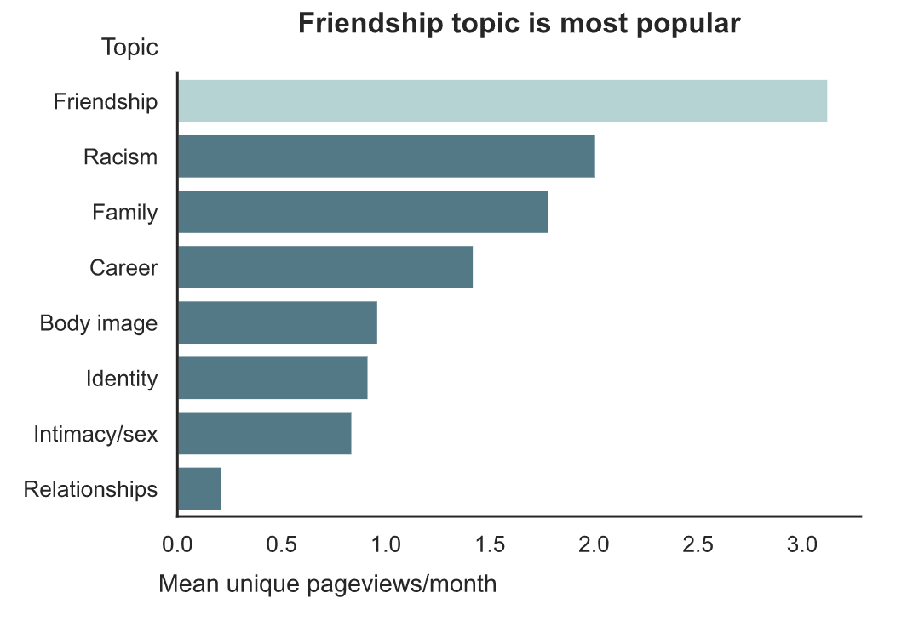
Topic popularity

Slide 7
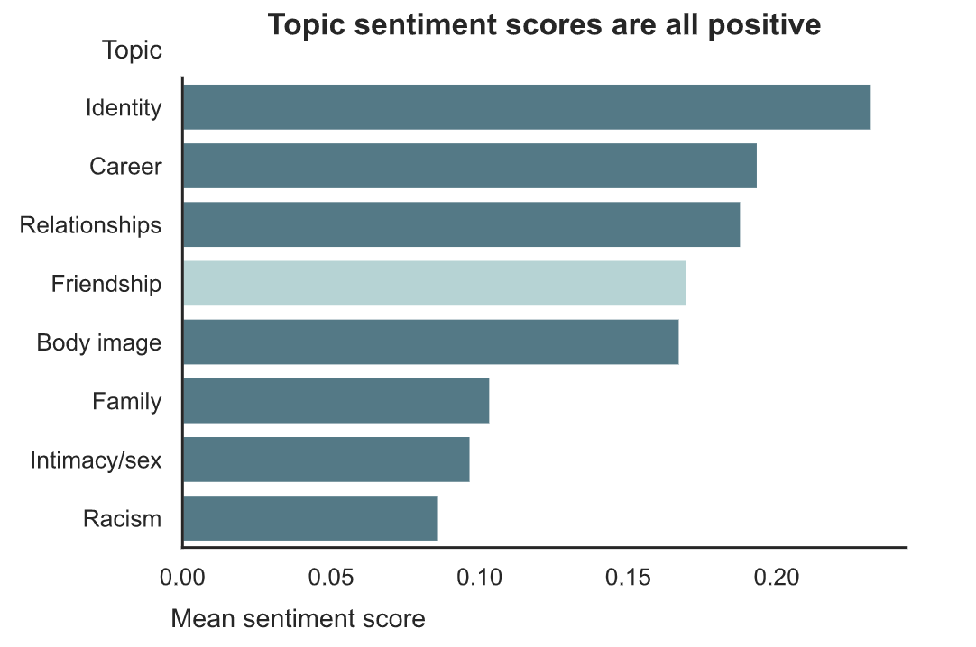

Topic sentiment using VADER
Why are these scores all positive? 😮
VADER
Score range: -1 to 1
😄 Positive sentiment: >=0.05
😐 Neutral sentiment: -0.05 – 0.05
😭 Negative sentiment: <= -0.05
Methodology note
Sentiment scores calculated for each sentence and then averaged per blog post.

Slide 8
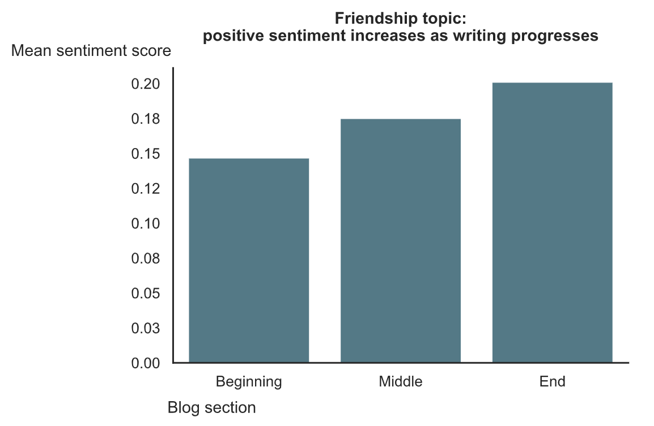
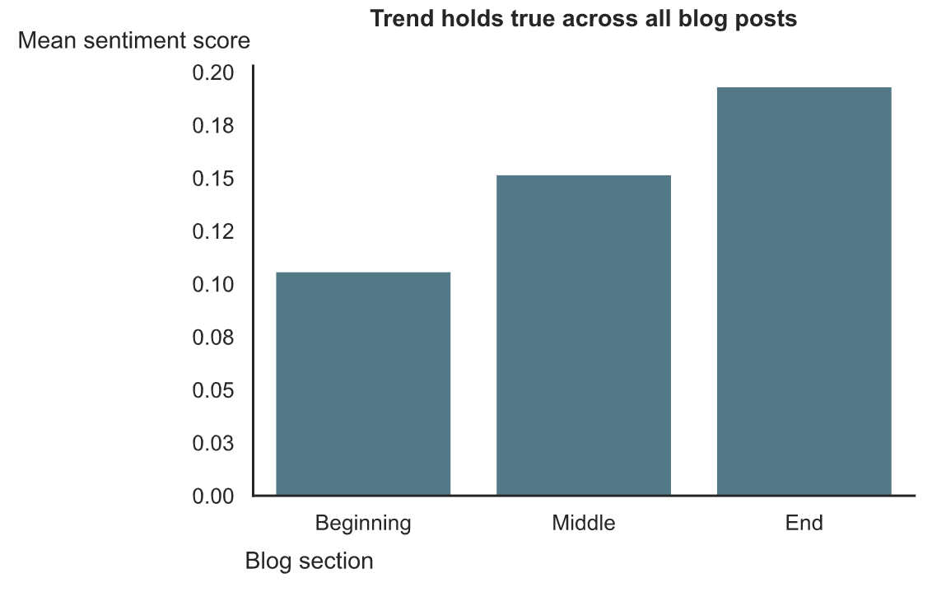
Sectional sentiment analysis

Slide 9
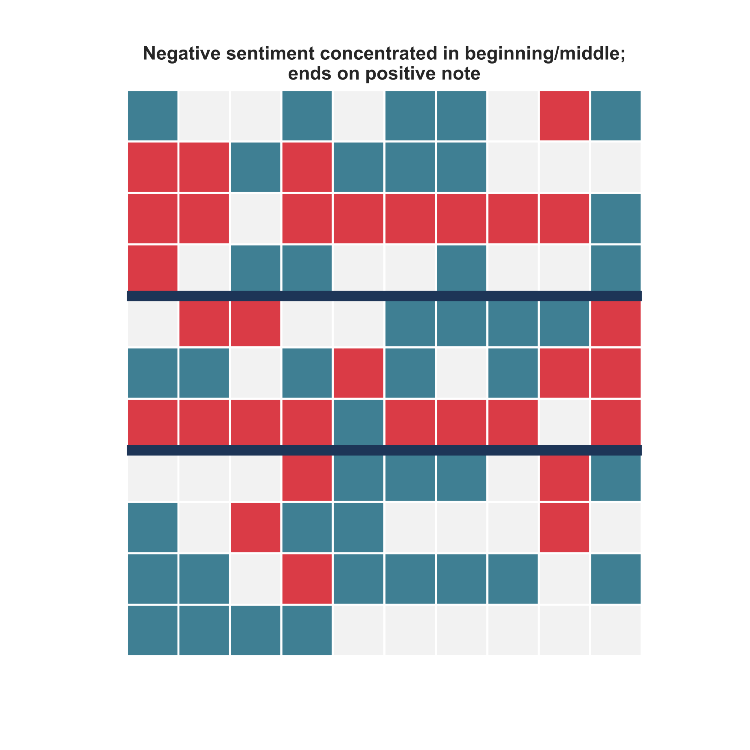
Sentiment map: gaysian diary entry #5
Sentence order: →↓
Instead, I found my first heartbreaks, shame, meaningless hookups and fear of catching some unwanted bugs.
Beginning
Score = -0.01
😄
😐
😭
I was hurt, jaded and cynical,
and I hated gay guys.
Middle
Score = -0.05
…I hope the next generation of gaysians coming to terms with their identities will have different, more positive and supportive “firsts”.
End
Score = 0.18

Slide 10


Conclusion
The upward trend in sentiment says something about the queer and trans API community (and possibly about humans in general), that despite the hardships that a marginalized community faces, many still hold hope for a better tomorrow.
Beginning
End

Slide 11
Future work
Scale up to include other social media posts: Twitter, Facebook, Reddit
Compare and contrast blogs of queer and trans API community with other queer and trans communities’

Slide 12
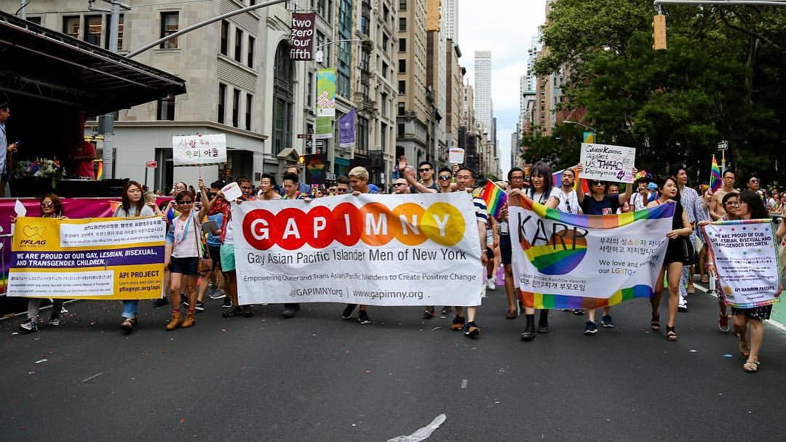
Thank you!

